Slide 1
Lecture 2 Quiz
3 questions, 60s each

Slide 2
Graded Quiz Question #1
Which macromolecule has the highest Atwater factor
Carbohydrate
Protein
Fat
Alcohol

Slide 3
Graded Quiz Question #2
Which statement is most true about the relationship between obesity and metabolic rate?
Obesity is associated with lower metabolic rate, resulting in positive energy balance
Obesity is associated with lower metabolic rate, due to increased lean mass
Obesity is associated with higher metabolic rate, due to increases in thermic effect of food
Obesity is associated with higher metabolic rate, due to increases in the basal metabolic rate

Slide 4
Graded Quiz Question #3
Glucagon acts very rapidly and results in an decreased activity of FBPase. What is the most plausible explanation?
Glucagon allosterically activates FBPase by increasing the amounts of ATP
Glucagon causes transcriptional downregulation of FBPase by inhibiting CREB
Glucagon results in an inhibitory phosphorylation of FBPase via PKA
Glucagon causes DNA methylation at the FBPase gene to reduce transcription

Slide 5
Metabolic Control Systems
Energy balance with a very brief review of biochemistry and endocrinology

Slide 6
Learning Objectives
Apply the concept of energy balance to understanding weight gain and weight loss.
Explain the differences in energy content of various macronutrients.
Differentiate between the components of energy intake and energy expenditure and how evaluate how these contribute to energy balance.
Interpret how energy intake and energy expenditure are assessed, including the biases and limitations of these methods.
Understand how energy balance and its various sub-components are changed in response to dieting.

Slide 7
Background

Slide 8
Background concepts
Some basic enzymology concepts
Allosteric regulation, metabolic flux, thermodynamics, energy
Enzymatic regulation of various types
An understanding of endocrinology
understanding of the roles of key metabolic hormones (insulin, glucagon, glucocorticoids, adrenaline, growth hormone)
A general sense of signaling pathways (PKA, Akt/PKB, mTORC1) relevant to nutrition
Please come talk to us if you need help, or if the review handouts are not clear/sufficient for your needs

Slide 9
Problem Roulette Demonstration
Background review (physiology, biochemistry, digestion)
Test bank (583 questions currently)
Optional assignment (can do once per unit for 10 points each)

Slide 10
Biochemistry Review
Which, if any of these concepts is the most unclear to you?
Activation Energy of an Enzyme, Thermodynamics of a Reaction
Rate-Limiting Steps, Committed Steps and Metabolic Flux
Allosteric Control, Co-Operativity and the Physiological Range
Transcriptional or Post-Translational Regulation
Notes:
Slides for activation energy

Slide 11
If an enzyme is catalytically activated…
It reduces ΔG of the reaction, but does not change the rate
It reduces ΔG of the reaction, and does changes the rate
It doesn’t change the ΔG of the reaction, and does not change the rate
It doesn't change the ΔG of the reaction, but does not change the rate

Slide 12
Kinetics of Enzyme Reactions
Generally depends on amount of substrate/product
Stabilization of transition state

Slide 13
Committed or rate limiting steps?
Reversible step:
Substrates and products can quickly move back and forth
Committed step:
An effectively irreversible step along a metabolic pathway
Rate limiting step:
The slowest enzymatic reaction in a pathway
Committed and rate limiting steps are often the ones that regulate the flow of metabolites through the pathway

Slide 14
Co-operativity
Physiological
Range
Enzymatic Rate
Substrate Concentration

Slide 15
Which is an example of allosteric control of glycogen synthase?
Increasing the intracellular level of the substrate UDP-glucose makes GS add UDP-glucose to glycogen more rapidly
The transcription factor SREBP1c increases the amount of glycogen synthase in the cell
The non-substrate glucose-6-phosphate increases of GS activity
Both A and C

Slide 16
Enzymes are Regulated by Several Mechanisms
Speed
Substrate/Product Concentrations
Allosteric Control
Catalytic Activation
Enzyme Location
Enzyme Levels
Protein Level -> Translation/Degradation
Transcriptional Regulation
Permanence
Notes:
Allosteric Control

Slide 17
Several Levels of Metabolic Control
Intracellular
Substrate and products
Allosteric activators/inhibitors
Signals or metabolites that activate post-translational modifications
Transcription factors that respond to signals or metabolites
Integrated metabolic control
Endocrine signaling
Neural synapses

Slide 18
Example Post-Translational Metabolic Control System
AMP activated protein kinase (AMPK)
Activated when AMP/ATP level is high
What sorts of things would you expect this kinase may regulate?

Slide 19
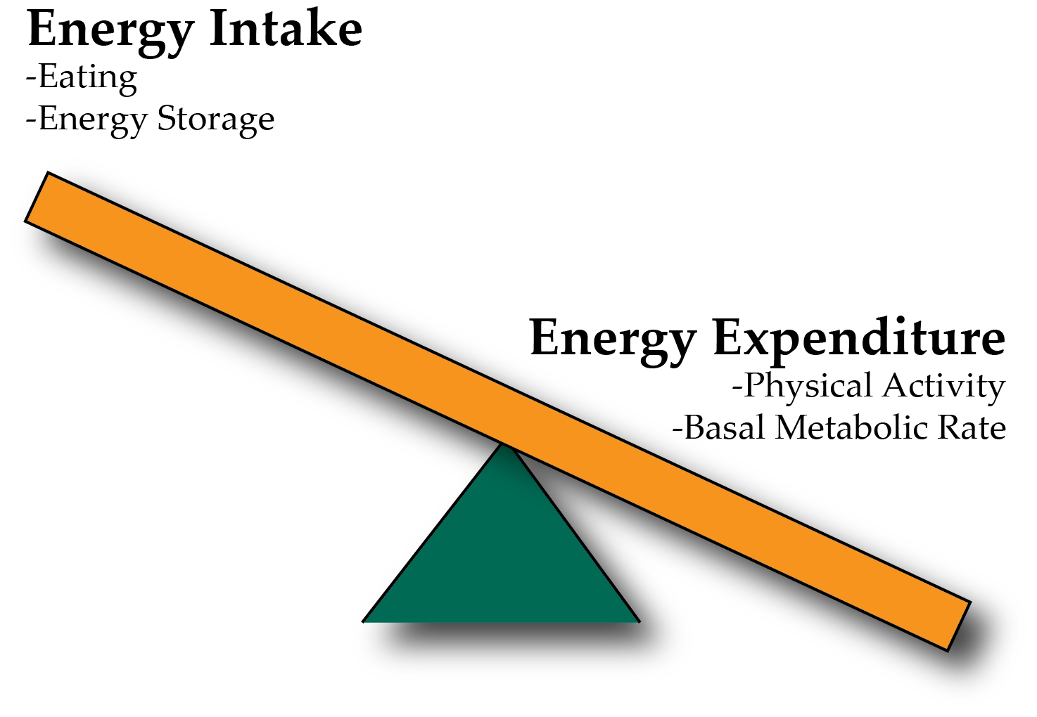
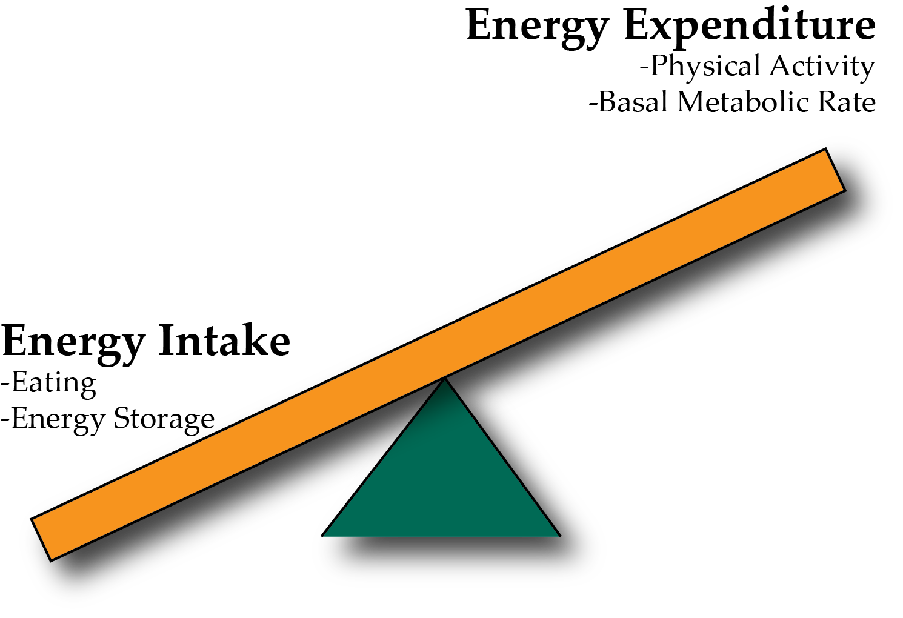
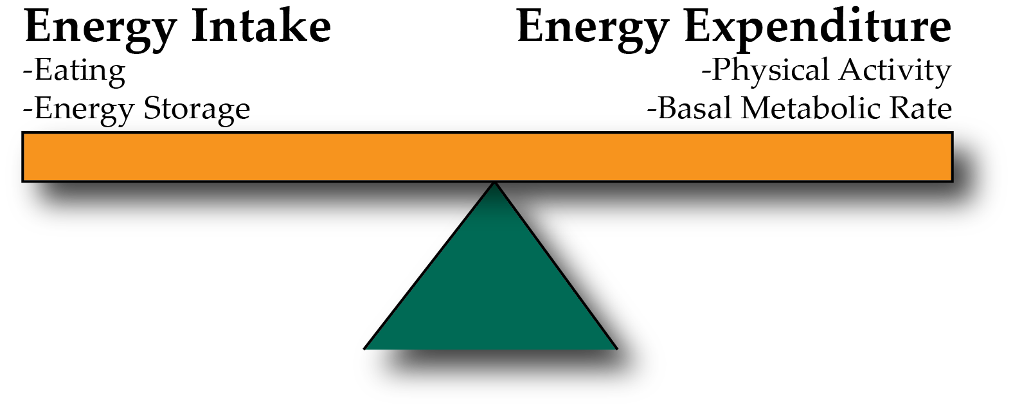
Energy Balance and Obesity
Positive Energy Balance – Weight Gain
Negative Energy Balance – Weight Loss

Slide 20
Energy Intake
Key Factors
Assessment of Energy Intake
Appetite, when to stop eating
Food Choices
Method of preparation
Digestion
How to assess?
Observational studies
Dietary recall (24h-1 week)
Food frequency questionnaires
Compare to databases of calorie and macronutrient amounts
Consider the accuracy and biases of these methods
More details on Canvas in Optional readings and in NUTR640
Notes:
Mention for the last two, efficiency

Slide 21
Methods of analyzing macronutrient intake
This is important for research purposes
Total macronutrient levels
Energy adjusted levels

Slide 22
Energy Expenditure

Slide 23
Parts of the Metabolic Rate Metabolic Rate
Maclean PS, Bergouignan A, Cornier M-A, Jackman MR. Biology’s response to dieting: the impetus for weight regain. Am. J. Physiol. Regul. Integr. Comp. Physiol. 2011;301(3):R581–R600. http://dx.doi.org/10.1152/ajpregu.00755.2010
Notes:
Impact of weight loss on the components of total energy expenditure (TEE). Energy-restricted weight loss impacts every component of energy expenditure. The absolute levels of resting energy expenditure (REE) decline from a loss of metabolic mass and enhanced metabolic efficiency. Nonresting energy expenditure (NREE) declines, unless the level of physical activity and its associated exercise activity thermogenesis (EAT) are substantially increased. This increase must overcome the decline in the TEF that results from lower energy consumption and a decline in nonexercise activity thermogenesis (NEAT) related to loss in overall mass. Increased energetic efficiency of EAT, NEAT, and potentially TEF contribute to the overall decline in NREE.

Slide 24
Modifiers of energy expenditure
Energy Expenditure Component | Increased by
EAT (Exercise Activity Thermogenesis) | Exercise
TEF/DIT (Thermic Effect of Food) | Protein in Meal, Insulin Sensitivity, Meal Size
BMR/SMR/REE (Basal Metabolic Rate) | Young Age, Sex (M), Lean Mass, Set Point

Slide 25
All other things being equal, what do you think is the energy balance difference between whole and skim milk?
Increased energy intake in whole milk due to macronutrient content
Decreased energy intake in whole milk due to inefficient absorption
Increased energy expenditure for whole milk due to increased protein
Decreased energy expenditure for whole milk due to increased carbohydrates

Slide 26
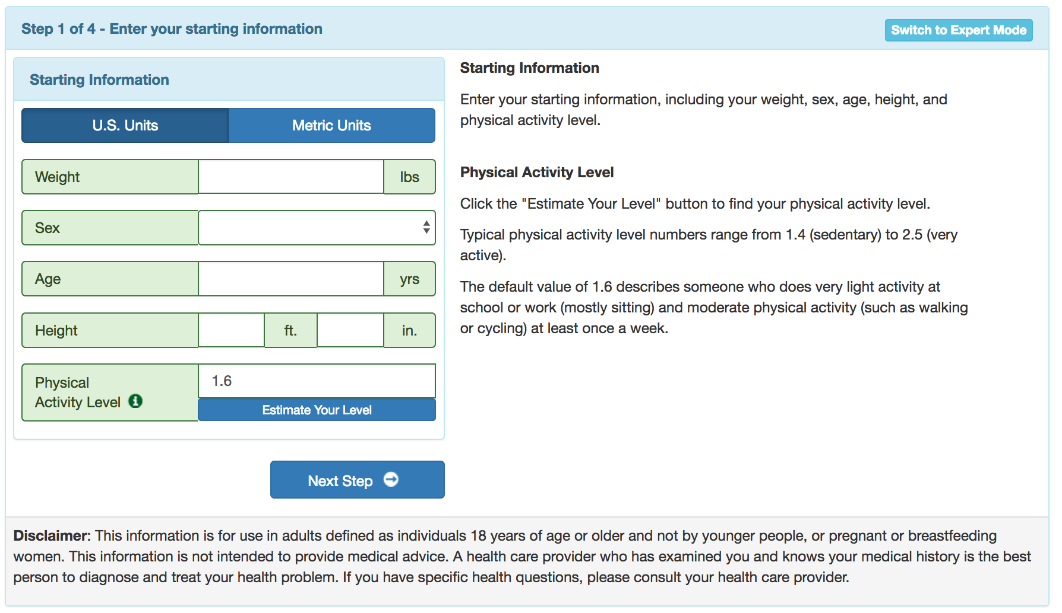
Estimating Total Daily Energy Expenditure
Many methods exist. I like the supertracker by the NIH: https://www.supertracker.usda.gov/bwp/index.html

Slide 27
What is heat and why is it relevant for energy expenditure?
Thermogenesis is the generation of heat from metabolic processes.
Metabolic efficiency is the percent of energy intake that is stored
Metabolic inefficiency is the percent of energy intake that is released (either as heat, or excreted)
Most of energy captured as ATP/NADH/FADH₂ but for each reaction a small amount is released as heat

Slide 28
Sources of Metabolic Inefficiency
Is food completely absorbed into the body?
Cost of doing business
Energy is released to break peptide bonds
Energy is needed to reform peptide bonds
Futile cycles
TCA Cycle Products

Slide 29
How do we measure metabolic rates
Doubly Labelled Water

Slide 30
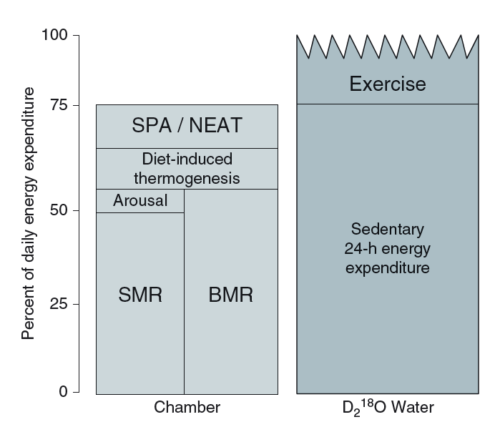
Think, Pair, Share: Strengths and Limitations of Indirect Calorimetry vs Doubly Labelled Water
Think about it yourself for 2 mins
Talk to someone near you for 2 mins
Bring it back to the group

Slide 31
How do you think over-eating alters the basal metabolic rate?
I think metabolic rate would be lower after over-eating
I think metabolic rate would be higher after over-eating
What do you think fasting or caloric restriction would do to the metabolic rate?

Slide 32
Over/underfeeding and metabolic rates
Leibel R, Osenbaum MIR, Leibel RL, Rosenbaum M, Hirsch J. Changes in energy expenditure resulting from altered body weight. N. Engl. J. Med. 1995;332(10):621–8. http://dx.doi.org/10.1056/NEJM199503093321001

Slide 33
The Biggest Loser Follow-Up Study
Fothergill E, Guo J, Howard L, Kerns JC, Knuth ND, Brychta R, Chen KY, Skarulis MC, Walter M, Walter PJ, Hall KD. Persistent metabolic adaptation 6 years after “The Biggest Loser” competition. Obesity. 2016; 24: 1612–9. doi: 10.1002/oby.21538.
Notes:
Those with sustained weight loss, did so even in spite of a more pronounced reduction in RMR after 6 years

Slide 34
Think, Pair Share: What is going on here?
Question: Why did more the people who regained the least weight have the largest reduction in energy expenditure?
Think about it yourself for 2 mins
Talk to someone near you for 2 mins
Bring it back to the group

Slide 35
Learning Objectives
Apply the concept of energy balance to understanding weight gain and weight loss.
Explain the differences in energy content of various macronutrients.
Differentiate between the components of energy intake and energy expenditure and how evaluate how these contribute to energy balance.
Interpret how energy intake and energy expenditure are assessed, including the biases and limitations of these methods.
Understand how energy balance and its various sub-components are changed in response to dieting.

